Slide 1




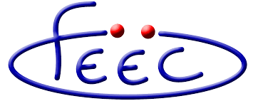
Motion artifacts in MRI Irene Fantini School of Electrical and Computer Engineering, University of Campinas

Slide 2
Agenda
Motivation
Proposal
Material&Methods
Results& Discussion
Conclusion

Slide 3

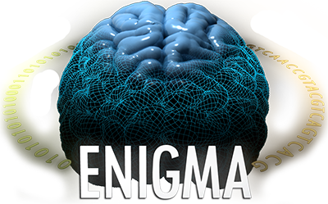




Motivation
Calgary Normative Study

Slide 4
Motivation
PARTICIPANTS
25000
31000
3158
554
Calgary Normative Study
1112
300

Slide 5
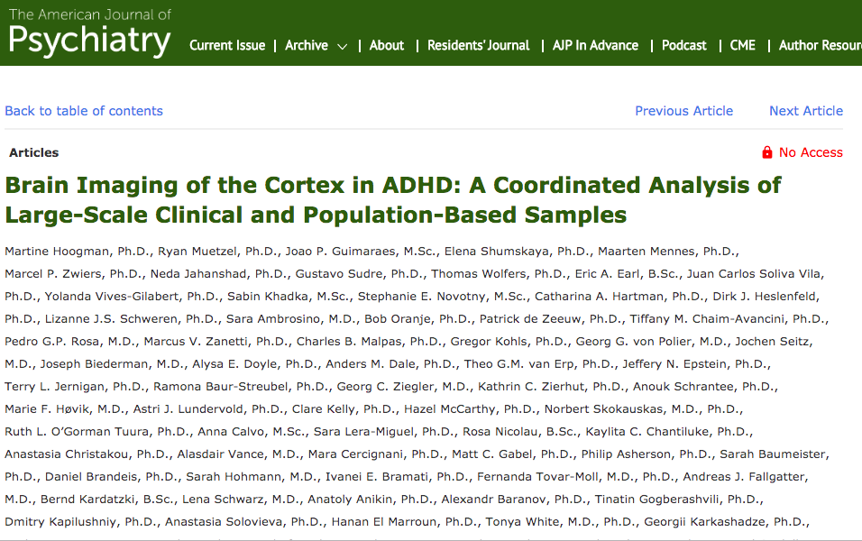
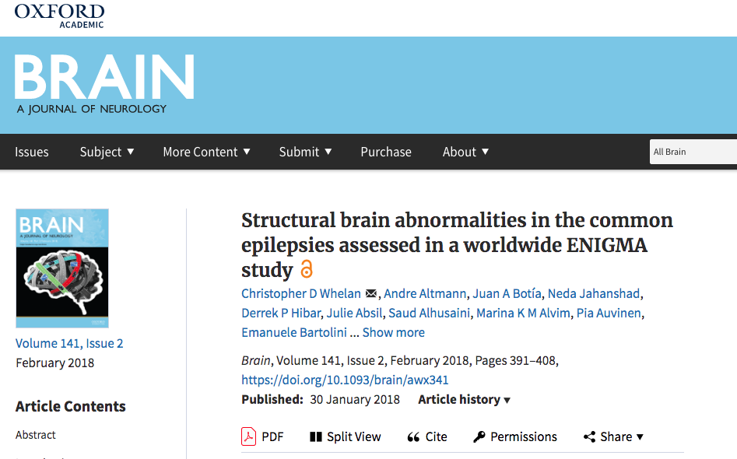
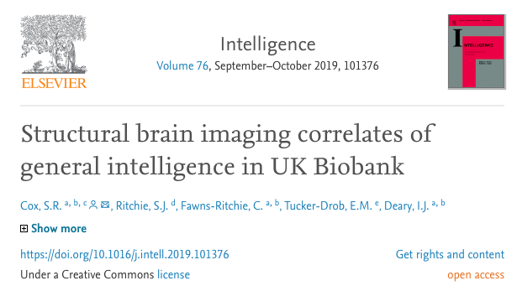

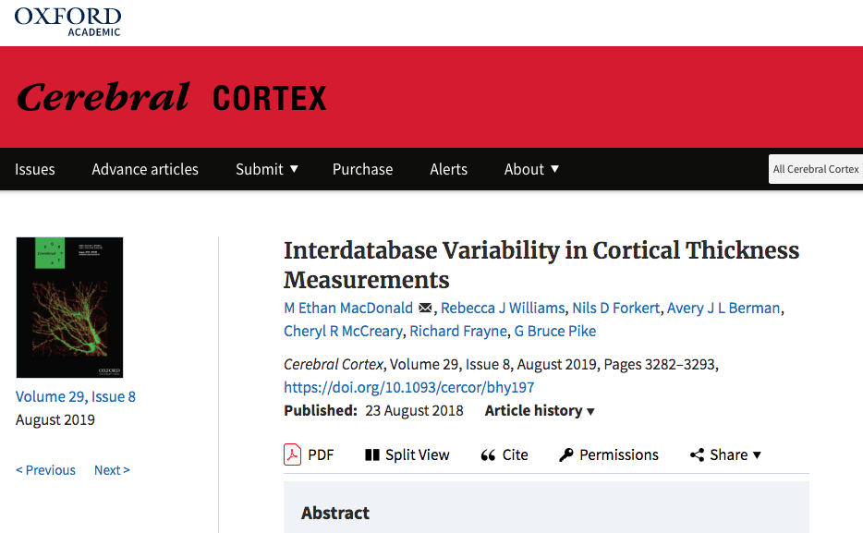

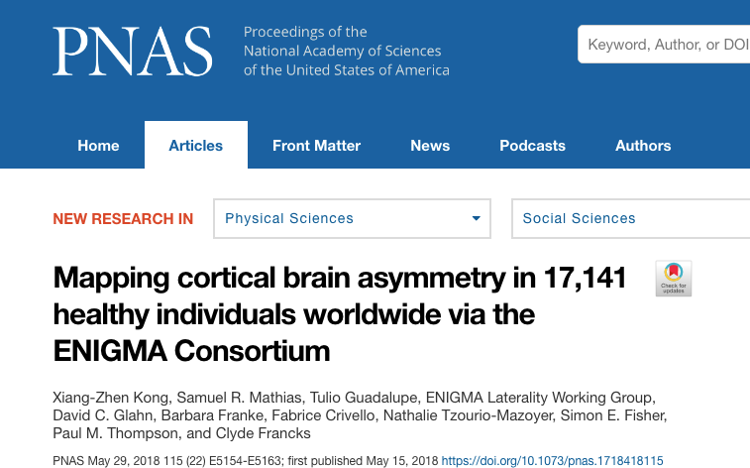
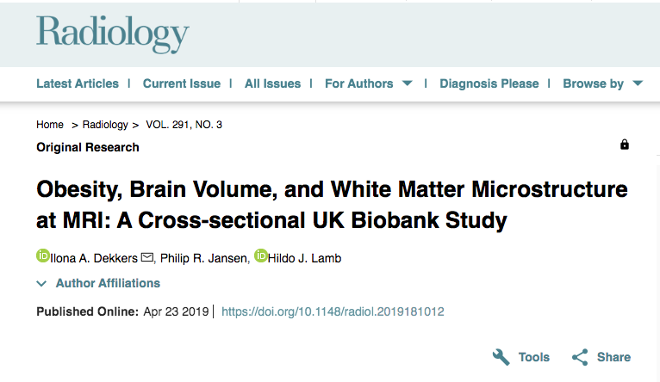
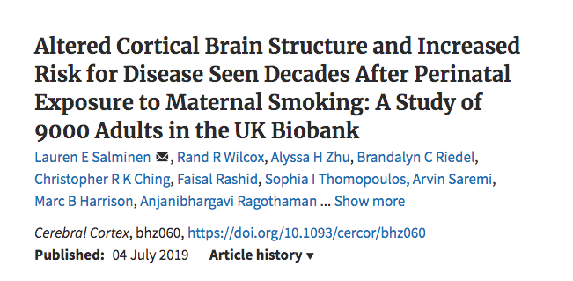
Motivation: Publications

Slide 6
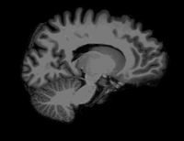
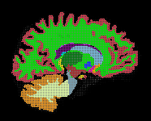
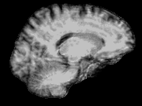
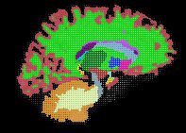
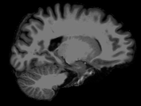
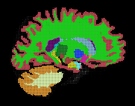
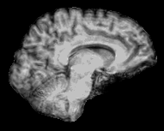
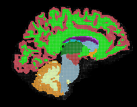
Motivation: Segmentation
Motion free
Motion artifacts

Slide 7
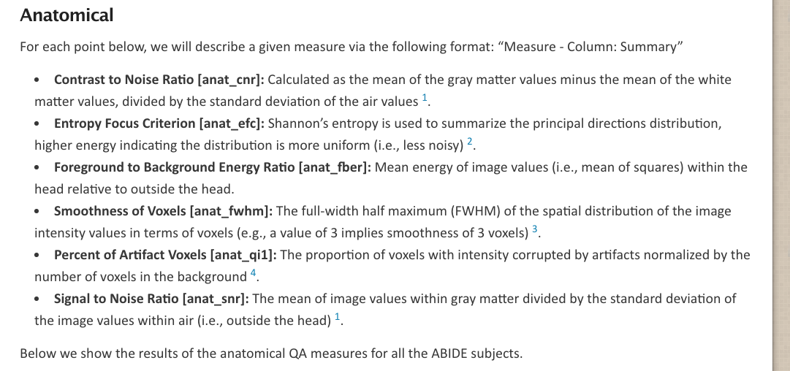
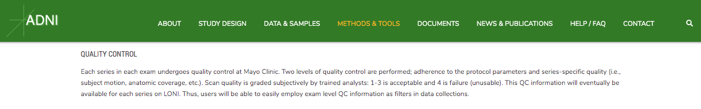
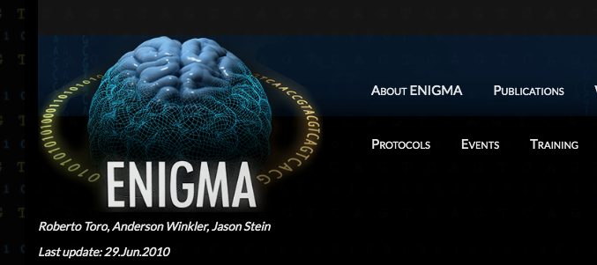
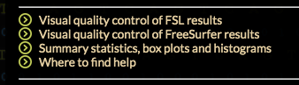

Motivation: Quality assessment

Slide 8
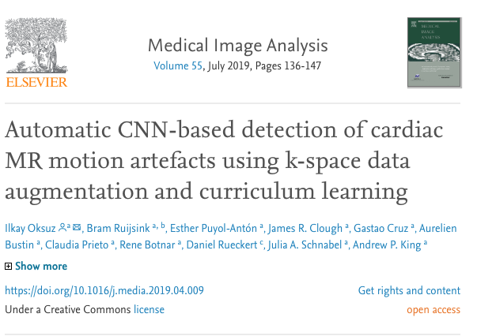
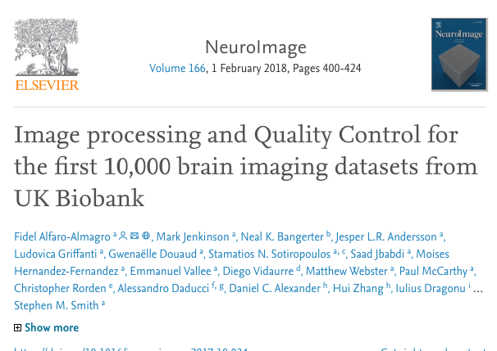
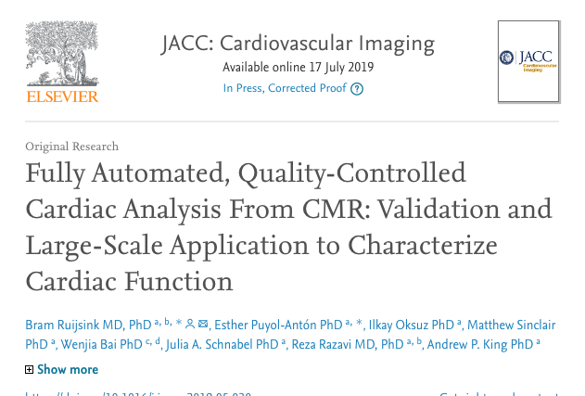
Motivation: Quality assessment
ADNI has a recall list – 679 images
UKBiobank has studies to automate the quality assessment

Slide 9
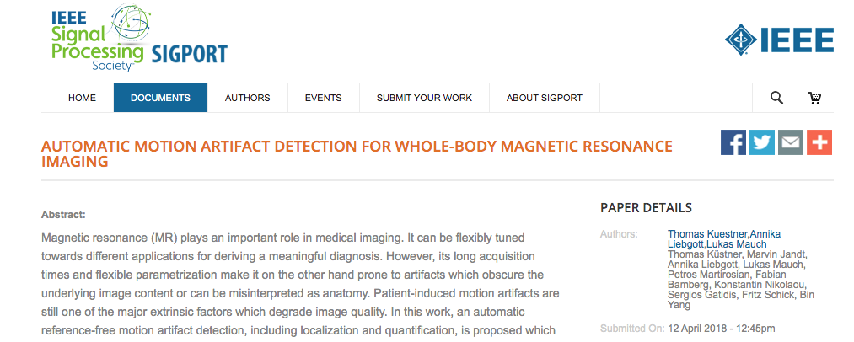
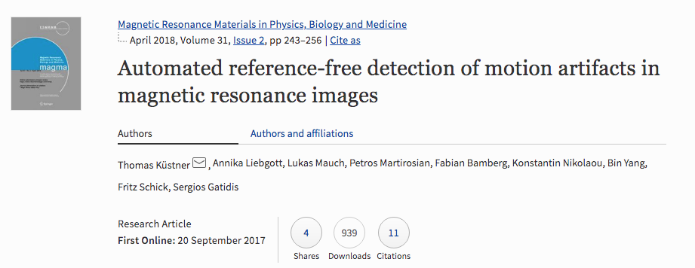
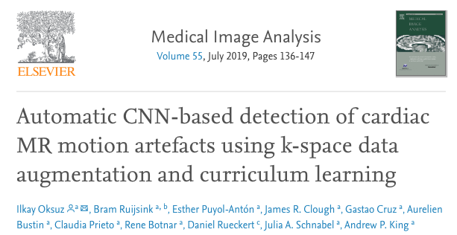
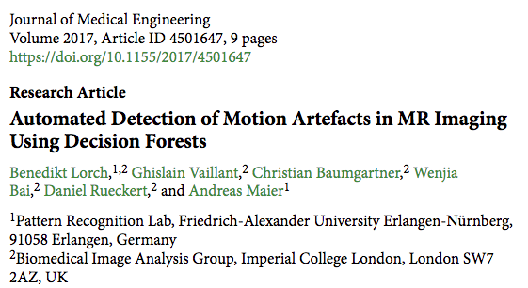
Motivation

Slide 10
Agenda
Motivation
Proposal
Material&Methods
Results& Discussion
Conclusion

Slide 11
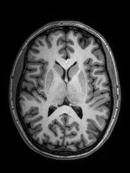
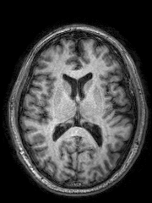
Proposal
Provide a scale that reflects the probability of motion-corruption on a acquisition
Motion-corrupted
Deep CNN presents good performance on image classification and segmentation
Motion-free

Slide 12
Agenda
Motivation
Proposal
Material&Methods
Results& Discussion
Conclusion

Slide 13
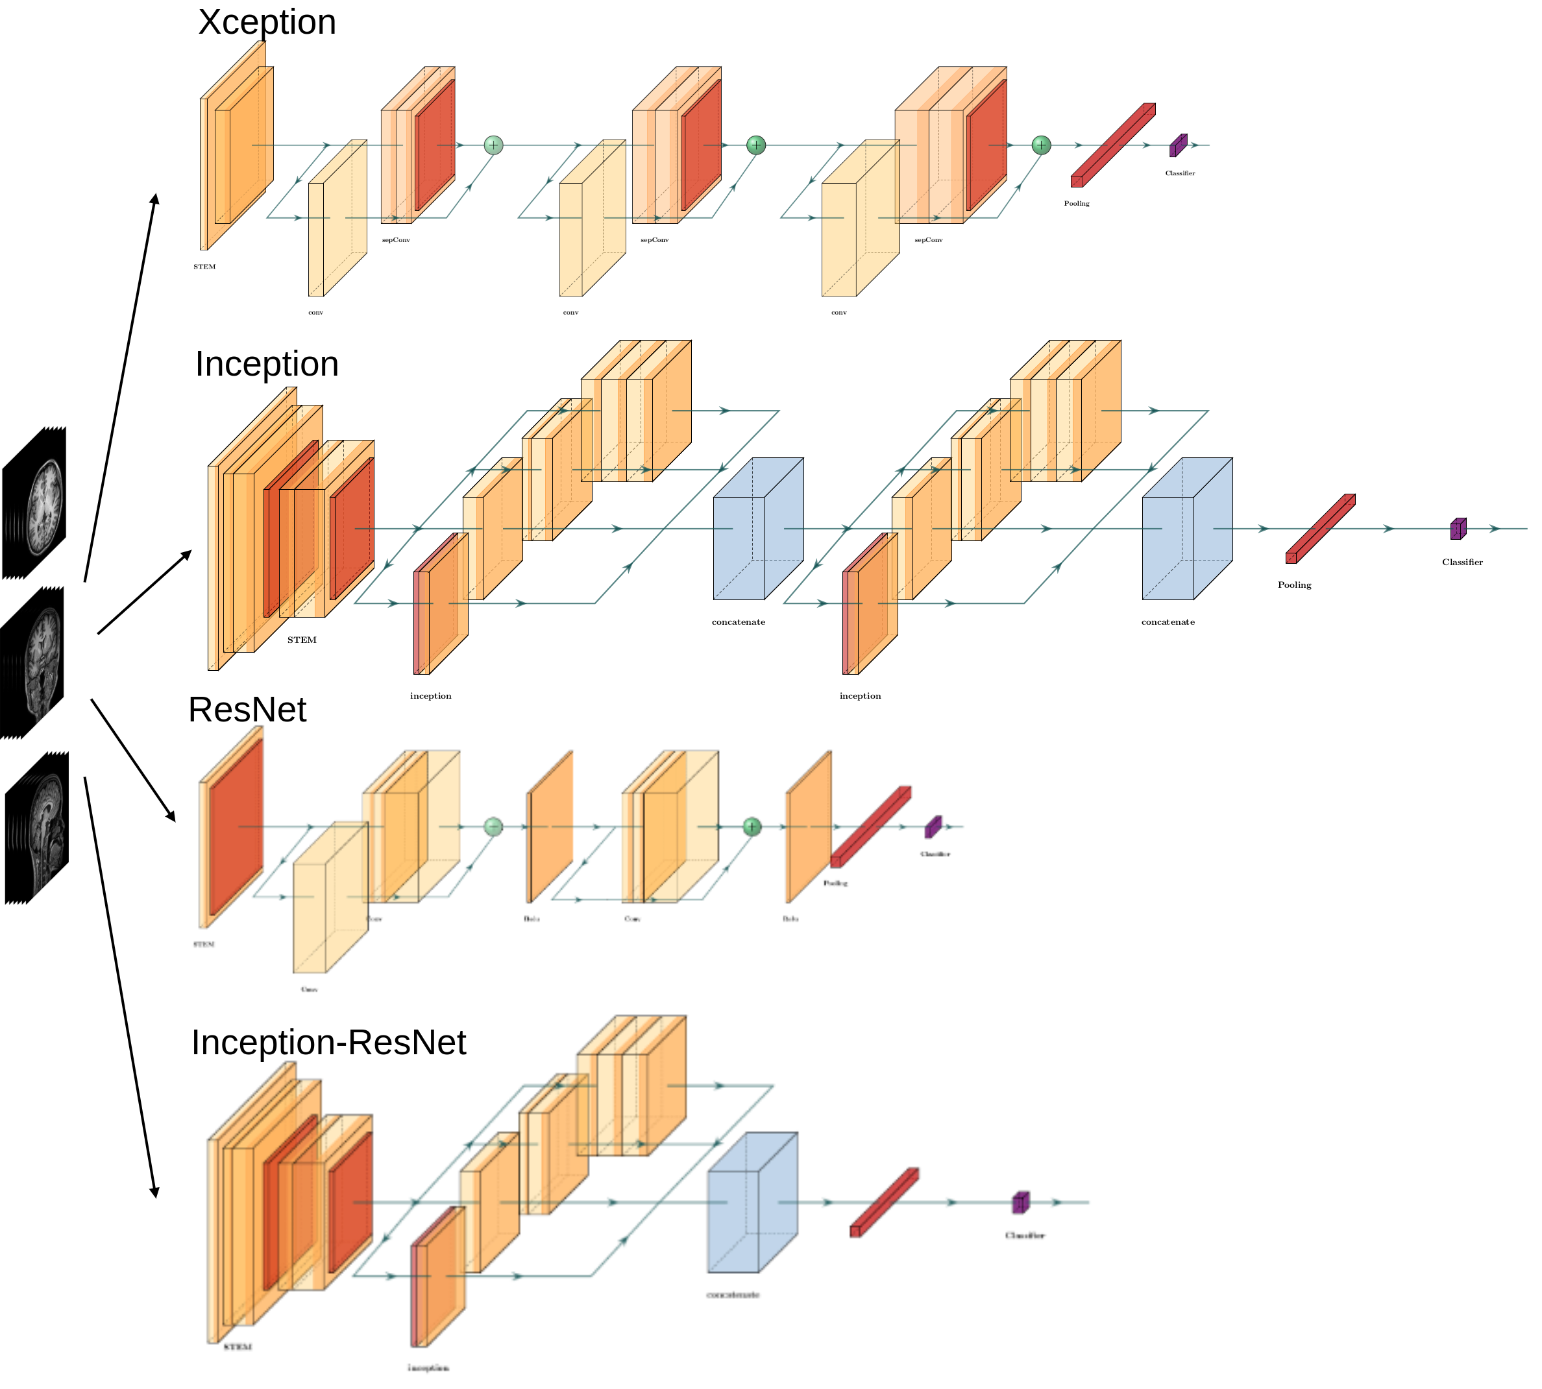
Material&Methods
Initial convolution layers detect edges from images
Modified four different architectures: Xception, Inception, ResNet and Inception-ResNet
Fine-tuned the four architectures for each MR orthogonal plane

Slide 14
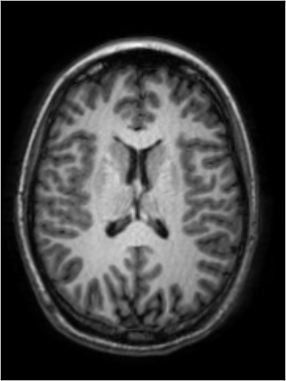
Material&Methods: data
Data:
68 T1-weighted volumetric MRI
48 training/validation
20 testing
Used 40 central slices
Bounding box around the brain structure
Trained on 128x128-sized patches
Tested on whole slice
Annotation:
Visually checked the border between the white-matter and gray-matter
Motion features:
Ghosting
Ringing
Blurring

Slide 15
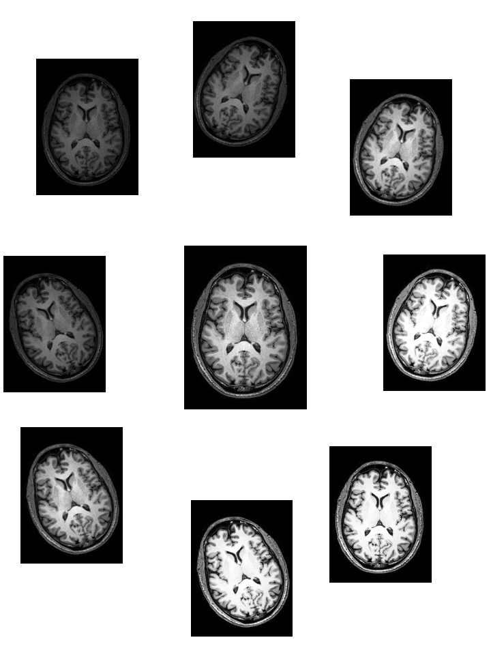
Material&Methods: data
Deep CNNs require large dataset to training
Data augmentation:
Rotation
Random crop (translation)
Brightness transformations

Slide 16
Agenda
Motivation
Proposal
Material&Methods
Results & Discussion
Conclusion

Slide 17
Results
Sagittal axis presents the lowest performance
Inception have the best result for sagittal axis
 | Xception | Inception | ResNet | Inception-ResNet
Axial | 95% | 94% | 89% | 90%
Coronal | 96% | 97% | 87% | 92%
Sagittal | 78% | 92% | 81% | 90%

Slide 18
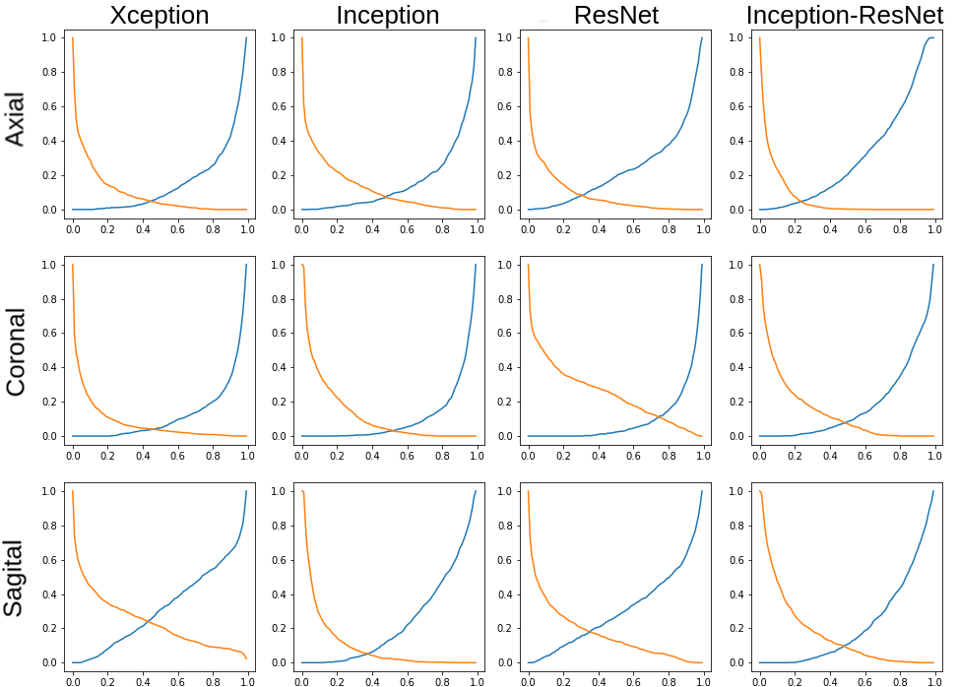
Results
False Positives curve - Orange
False Negative curve – Blue
High FP and FN rates in sagital curves.
ResNet also shows rates inbalance

Slide 19
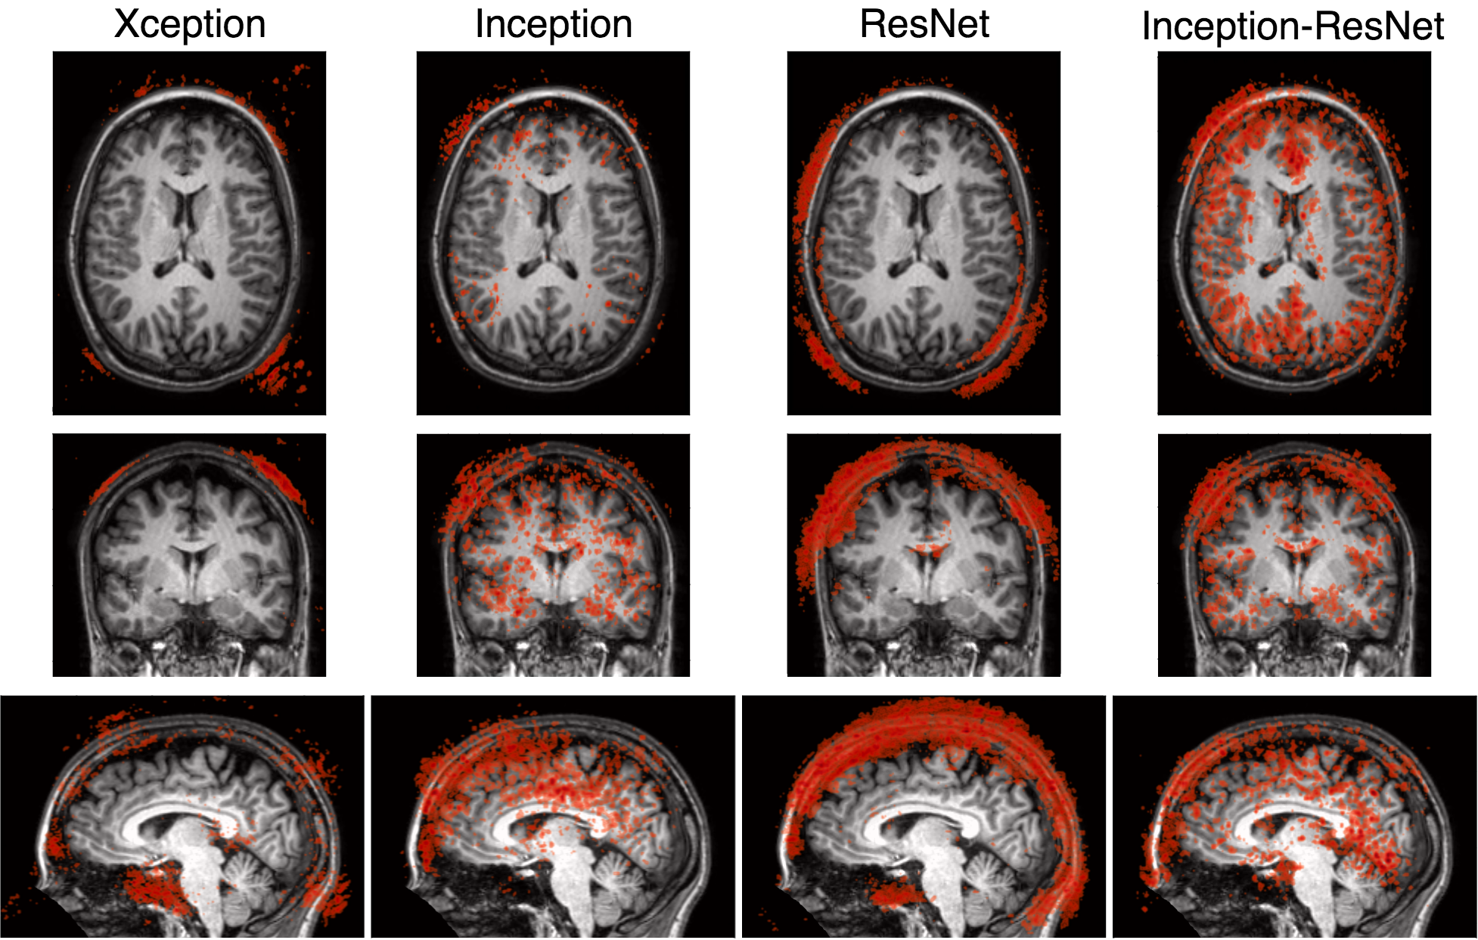
Which information is Deep Learning getting?
Information is coherent throughout the axes (per architecture)
Inception and Inception-ResNet also extract information from gray- and white-matter

Slide 20
Discussion
All models were trained using the same hyperparameters and number of samples
FP and FN curves suggest that some models were under trained
Xception and ResNet extracted information from sphenoid sinus

Slide 21
Agenda
Motivation
Proposal
Material&Methods
Results
Conclusion

Slide 22
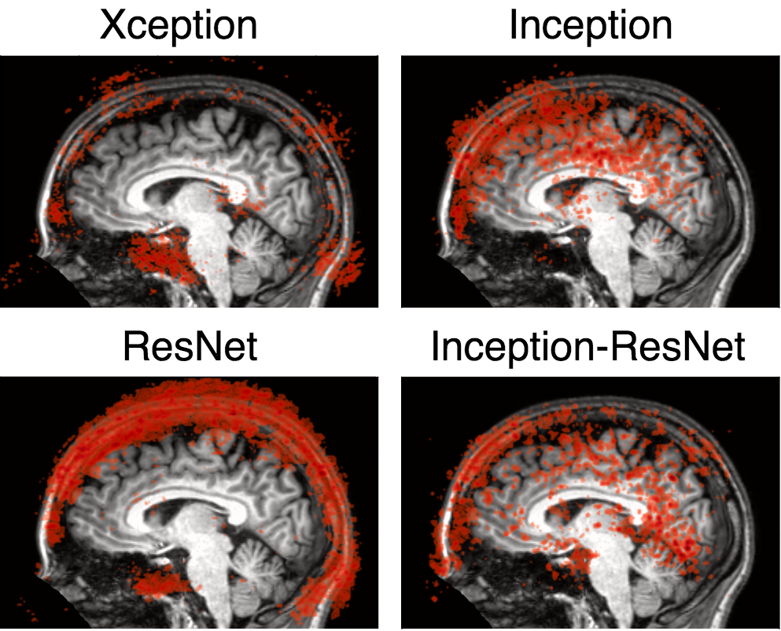
Conclusion
Classifiers that have considered information from white- and gray-matter have a better performance that those that considered mainly the background and CSF.

Slide 23
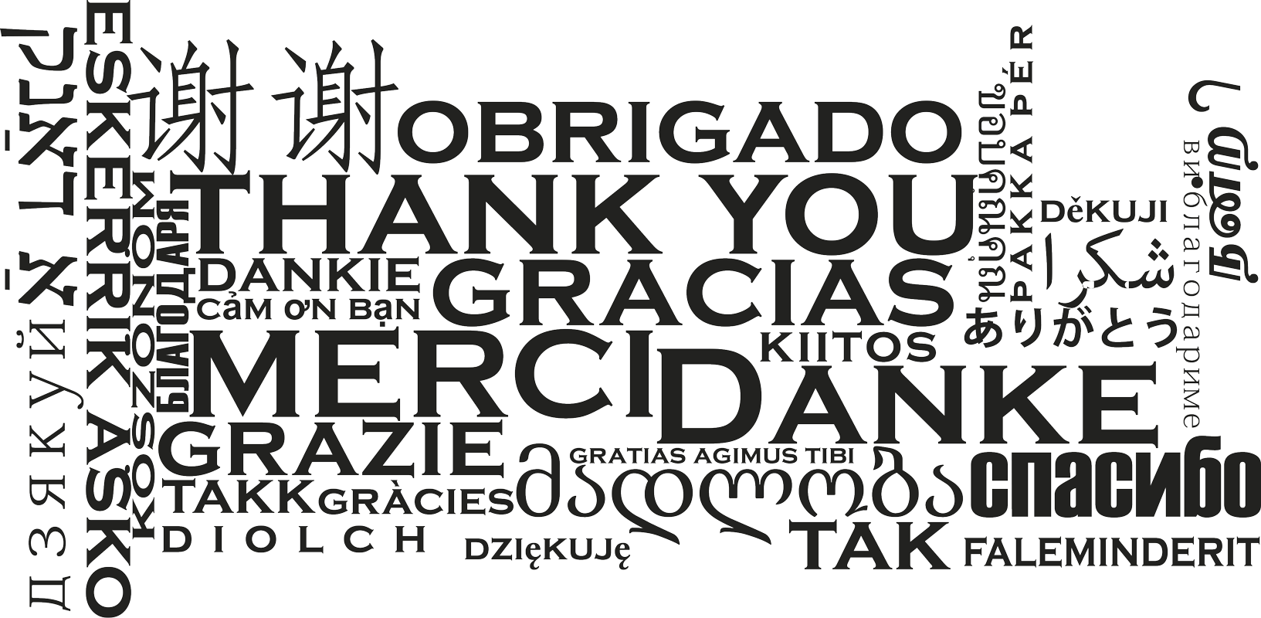

Slide 24
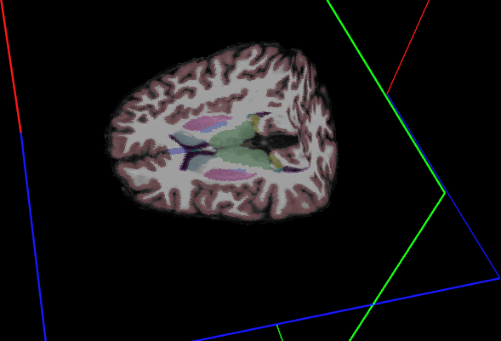
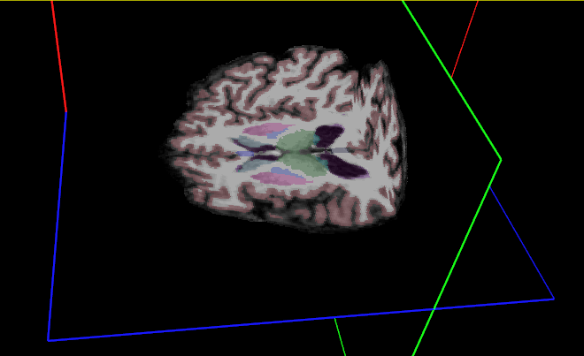
Motivation: Segmentation
Motion free
Motion artifacts

Slide 25
Results
very different on sagittal axis
similar on axial and coronal axes
 | Xception | Inception | ResNet | Inception-ResNet
Axial | 92.3% | 92.8% | 90.0% | 93.8%
Coronal | 93.8% | 93.5% | 84.2% | 90.2%
Sagittal | 77.1% | 91.8% | 79.8% | 89.9%

Slide 26
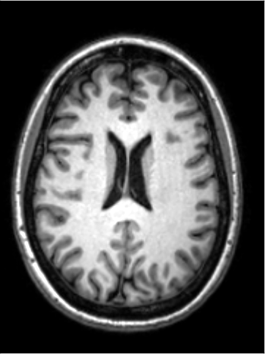
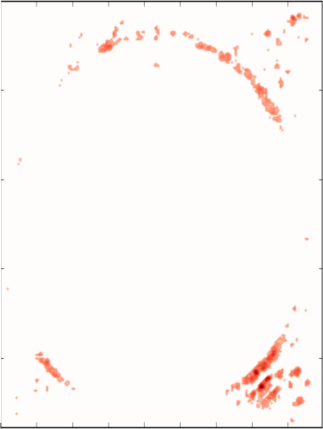
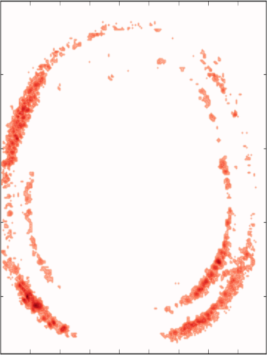
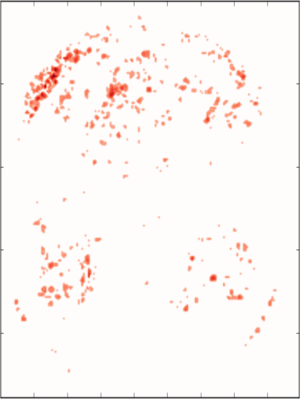
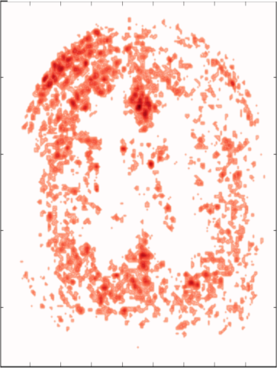
Visualizing the results
Which information is Deep Learning getting?
All models extract information from background
Inception and Inception-ResNet also extract information from gray- and white-matter
Xception
Inception
ResNet
Inception-ResNet

